Slide 1
Physical Rehabilitation Score Prediction Using Deep Learning: A Focus on LSTM, 3DCNN And Conv3D Performance.

Slide 2

Presented By:
Farhana Akter Bristy
ID : CSE 070 08110
Subrite Sarker
ID : CSE 070 08112
Dept. of CSE, Stamford University Bangladesh
Supervised By:
Md. Tauhid Bin Iqbal,
Ph.D
Assistant Professor
Dept. of CSE,
Stamford University Bangladesh

Slide 3
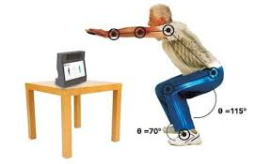
PRESENTATION CONTENTS
INTRODUCTION
EXPERIMENTS OF EXERCISE ASSESSMENT SCORING
DATASET COMPONENTS
TYPES OF EXERCISES
DATA PRE-PROCESSING
MODEL ARCHITECTURE
EXPERIMENTAL ANALAYSIS
FUTURE PLAN
REFERENCES

Slide 4

INTRODUCTION
Physical rehabilitation is a critical process for improving patient recovery after injuries or surgeries.
Traditional assessment methods often rely on subjective evaluation by clinicians.
Computer-aided assessment of physical rehabilitation entails evaluation of patient performance in completing exercises.
Rehabilitation assessment plays an essential role towards improving patient outcomes.
Patient can acknowledge that he/she is doing right or wrong.
We applied three models to develop and compare deep learning models for predicting physical rehabilitation assessment scores.
Comparison of model performance in terms of prediction error.

Slide 5
EXPERIMENTS OF EXERCISE ASSESSMENT SCORING
Primary goal: To evaluate deep learning models for predicting physical rehabilitation assessment scores based on rehabilitation exercises, with the aim of identifying the most effective model that minimizes prediction error.
Used dataset : MobiPhysio
Selected deep learning models for experiment:
Long Short-Term Memory (LSTM)
3D Convolutional Neural Network (3D-CNN)
3D-CNN+LSTM hybrid model (CONV3D)

Slide 6
DATASET COMPONENTS
We have 9 types of exercise in our dataset .
Each type or each class contains 80 videos.
1,920p average number of width per video.
1,080p average numbers of height per video.
30 average frames per second for every video.
We have 9 csv file for 9 classes, each csv file contains exercise names and assessment scores for each video.

Slide 7
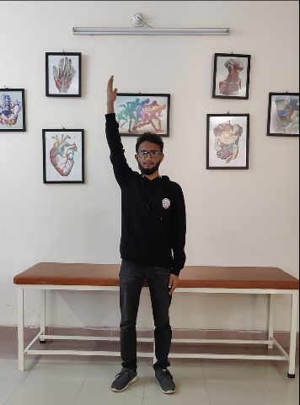
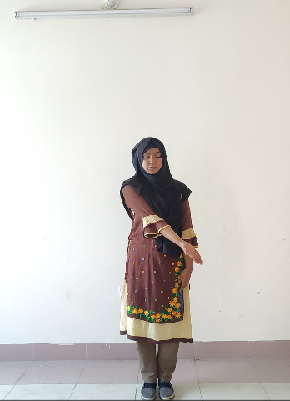
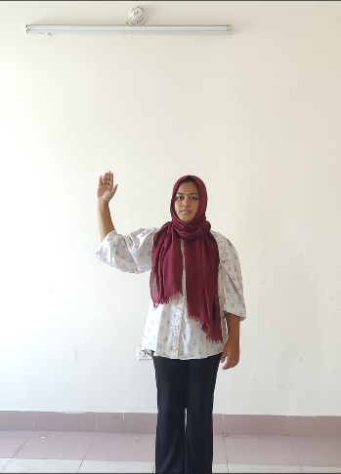
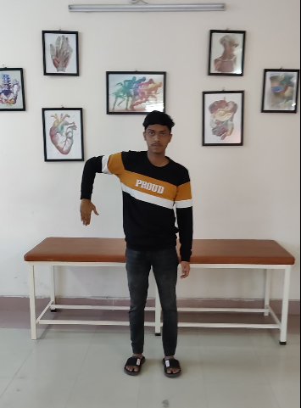
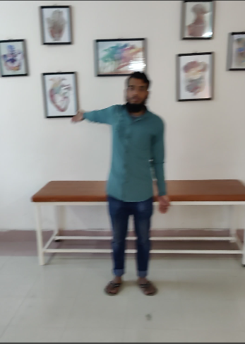
TYPES OF EXERCISES
Figure-1:E01(Abduction)
Figure-2:E02(Aduction)
Figure-3:E03(Lateral_Rotation)
Figure-4:E04(Medial_Rotation)
Figure-5:E05(Circumduction)

Slide 8
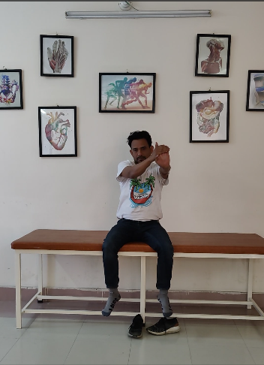
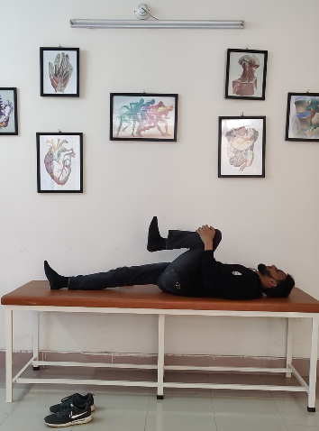
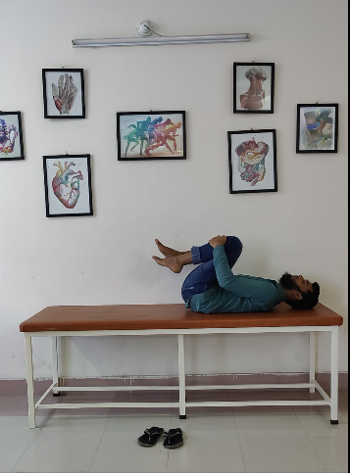
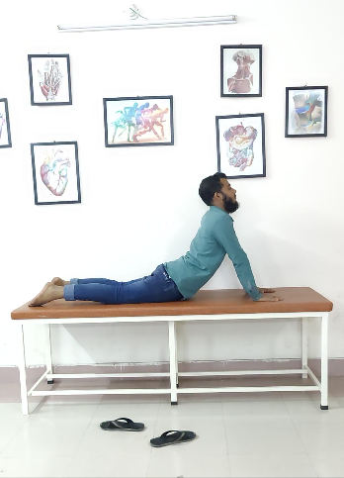
TYPES OF EXERCISES
Figure-6:E06(Wrist_Extension)
Figure-7:E07(Hip_Joint_Flexion)
Figure-8:E08(Both_Leg_Flexion)
Figure-9:E09(Back _Extension)

Slide 9
DATA PRE-PROCESSING
At first we load the dataset and read the video files from the dataset.
For computational reduction , we resized the frames to a fixed dimension of 128*128.
Set the sequence length to 30.
Normalized the Pixel values to the range [0, 1] by dividing by 255 , which makes convergence faster while training the network.
By using frames_extraction() function , we extracted frames from the videos.
Each processed frame will be appended to the frames_list.
We split the dataset into 0.2 ratio, which means 80% for training and 20% for test.

Slide 10
DATA PRE-PROCESSING
For model training, we used epoch=60, batch size= 8 and optimizer = adam.
We used learning Rate Scheduler(lr_scheduler) for adjusting the learning rate during the training process, because scheduling allows the learning rate to adapt during training, starting higher for faster progress and decreasing as the model approaches convergence and proper adjustment of learning rate is critical to achieving optimal training performance.
We used early_stopping for preventing overfitting problem.
We merged the video dataset with the csv file for data pre-processing.

Slide 11
MODEL ARCHITECTURE
LSTM: Long-Short Term Memory:
LSTM (Long Short-Term Memory) is a recurrent neural network (RNN) architecture.
One reason for the success of this recurrent network lies in its ability to handle the vanishing gradient problem.
vanishing gradient problem : Occurs when the gradients of the loss function with respect to the model parameters (weights) become very small during backpropagation, making it difficult for the network to update the weights effectively.
It excels at capturing long-term dependencies, making it ideal for sequence prediction task.
It has gating units which regulate the information flow into and out of the memory.

Slide 12
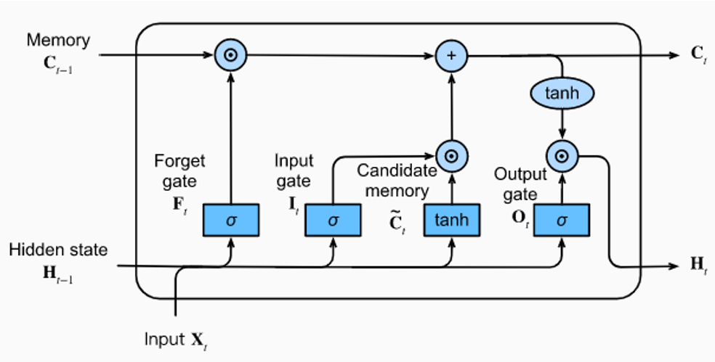
MODEL ARCHITECTURE
LSTM: Long-Short Term Memory:
Figure-9: Inner architecture of a LSTM block

Slide 13
MODEL ARCHITECTURE
Components of LSTM:
LSTM
Memory cells
Gates
Hidden state
Forget gate
Input gate
Output gate

Slide 14
MODEL ARCHITECTURE
Input gate: Regulates the extent to which new information flows into the cell state.
Forget gate: Determines how much of the current cell state should be carried forward. It allows the network to reset parts of the cell state when they are no longer relevant.
Output gate: Controls how much of the cell state should be used to compute the output of the LSTM unit at the current time step.
Cell state or memory: Cell carries information across different time steps, enabling the network to remember previous information for long durations.
Hidden state: The hidden state is the output of the lstm unit for a particular time step and also serves as an input to the next time step. It combines short-term and long-term memory from the cell state and is controlled by the output gate.
Candidate memory: Determine how much new information should be considered and integrated into the LSTM's cell state during each time step.
Components of LSTM:

Slide 15
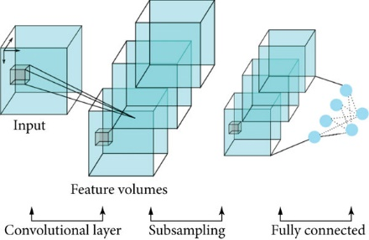
MODEL ARCHITECTURE
3D Convolutional Neural Network (3D-CNN) :
Figure-10: Architecture of a 3D-CNN model

Slide 16
MODEL ARCHITECTURE
3D Convolutional Neural Network (3D-CNN) :
It extends 2D convolution operations into three dimensions.
It can processes raw video directly without manual feature extraction.
3D CNNs use 3D filters (kernels) to extract features from input data. These kernels slide along the height, width, and depth dimensions.
This makes 3D CNNs capable of learning both spatial and temporal features simultaneously.
Similar to 2D CNNs, they build hierarchical representations of the data. Lower layers capture basic features like edges, while higher layers identify complex patterns like movement or object behaviour.
3D pooling layers reduce the dimensions of the feature maps while retaining important information. This reduces computational cost and prevents overfitting.
In Flatten Layer, 3D output Converts into a 1D feature vector.

Slide 17
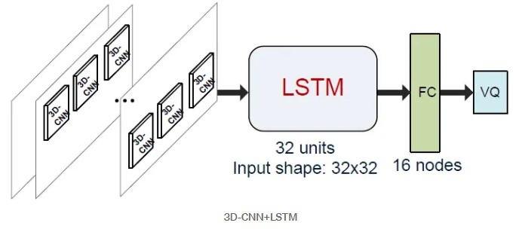
MODEL ARCHITECTURE
CNN-LSTM hybrid model (CONV3D):
Figure-11: Architecture of a CONV3D model [2]

Slide 18
MODEL ARCHITECTURE
CNN-LSTM hybrid model (CONV3D):
It’s a hybrid model. In Conv3d , we combine 3D-CNN model with LSTM .
3D-CNNs are utilized to extract local spatiotemporal features from small cubic clips in video.
Then, the extracted features are then fed into the LSTM networks to predict the perceived video quality.
Despite having insufficient training data, it can efficiently capture quality features.
In Conv3d model, the LSTM regressor contains an LSTM layer and another FC layer.
The input shape of the LSTM layer is determined by the number of video clips or frames extracted from a video sequence.
Two reasons Conv3d(3D-CNN + LSTM) perform better:
Descriptive capability of the 3D-CNN model for video quality perception and
LSTM can better represents the characteristics of the quality features in time series.

Slide 19
EXPERIMENTAL ANALAYSIS
Evaluation: We used RMSE , MAD and MAE for the performance matrix. We evaluate each model by using this matrix.
Exercise Name | LSTM | 3D-CNN | CONV3D
E01 | 0.32770 | 0.42400 | 0.02048
E02 | 0.29921 | 0.39245 | 0.03211
E03 | 0.22098 | 0.45555 | 0.01246
E04 | 0.25980 | 0.45555 | 0.00350
E05 | 0.12088 | 0.41792 | 0.00925
E06 | 0.33936 | 0.39131 | 0.01085
E07 | 0.21751 | 0.24458 | 0.01565
E08 | 0.35764 | 0.38612 | 0.00896
E09 | 0.27896 | 0.46823 | 0.00670
Exercise Name | LSTM | 3D-CNN | CONV3D
E01 | 0.04319 | 0.01681 | 0.00351
E02 | 0.04715 | 0.00590 | 0.00359
E03 | 0.10697 | 0.00754 | 0.00347
E04 | 0.11102 | 0.00754 | 0.00058
E05 | 0.06001 | 0.00529 | 0.00163
E06 | 0.02888 | 0.00408 | 0.00120
E07 | 0.08408 | 0.00776 | 0.00246
E08 | 0.01566 | 0.00834 | 0.00099
E09 | 0.04252 | 0.00598 | 0.00060
Figure-12: RMSE of LSTM, 3D-CNN, CONV3D model.
Figure-13:MAD of LSTM, 3D-CNN, CONV3D model.

Slide 20
EXPERIMENTAL ANALAYSIS
Exercise Name | LSTM | 3D-CNN | CONV3D
E01 | 0.32340 | 0.42337 | 0.01994
E02 | 0.29353 | 0.39037 | 0.03158
E03 | 0.17679 | 0.45546 | 0.01146
E04 | 0.22020 | 0.45546 | 0.00342
E05 | 0.08521 | 0.41785 | 0.00900
E06 | 0.33777 | 0.39128 | 0.01075
E07 | 0.18572 | 0.24458 | 0.01540
E08 | 0.35693 | 0.38589 | 0.00887
E09 | 0.27261 | 0.46816 | 0.00665
Figure-14: MAE of LSTM, 3D-CNN, CONV3D model.

Slide 21
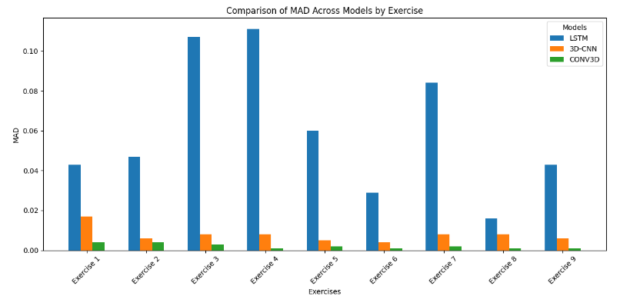
EXPERIMENTAL ANALAYSIS
Figure-15: Comparison of MAD between three models using bar chart.

Slide 22
EXPERIMENTAL ANALAYSIS
So from the bar chart , and from accuracy loss performance(RMSE, MAD, MAE ) we can see that Conv3d performed better in 9 exercises, than the other two model.
Conv3d have less RMSE, MAD and MAE that’s means it can captured movements and positions more correctly.
We have tested Conv3d model with new video and it gave an assessment score as output .

Slide 23
FUTURE PLAN
Updating the model in that way that it can return informative feedback along with assessment score.
Implement pose estimation algorithms (OpenPose, MediaPipe) to extract key joint angles during exercises.
Analyze joint angles to detect incorrect movements and highlight specific body parts where errors occur.

Slide 24
REFERENCES
[1] G. Van Houdt , C. Mosquera and G. N´apoles, “A Review on the Long Short-Term Memory Model,” Artificial Intelligence Review ,December 2020.
[2] Junyong You and Jari Korhonen, “ 3D-CNN+LSTM : Deep Neural Networks for No-Reference Video Quality Assessment”, 2019 IEEE International Conference on Image Processing (ICIP).
[3] Roberta Vrskova , Robert Hudec , Patrik Kamencay and Peter Sykora, “Human Activity Classification Using the 3DCNN Architecture,” Appl. Sci. 2022, 12(2), 931; Published: 17 January 2022.
[4] Noor Almaadeeda , Omar Elharroussa , Somaya Al-Maadeeda , Ahmed Bouridaneb and Azeddine Beghdadic , “A Novel Approach for Robust Multi Human Action Detection and Recognition based on 3-Dimentional Convolutional Neural Networks”, July 2019.

Slide 25
THANK YOU!

